Slide 1
Voices From The Field: Voices from the Field: The Opioid Crisis in Latinx Communities in Massachusetts
Moderator: Sarimer Sánchez, MD, MPH Medical Director, Infectious Diseases Bureau, Boston Public Health Commission

Slide 2
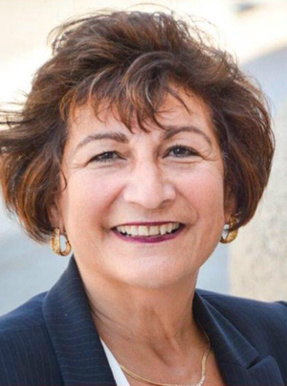
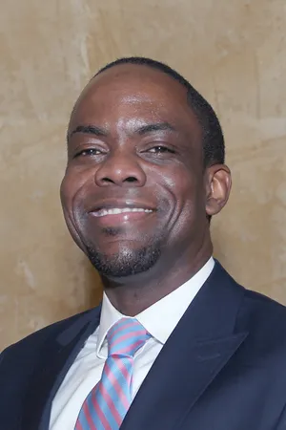

Slide 3
Questions
Overview of the opioid crisis in Latinx Communities and describe efforts that are being undertaken to tackle this crisis
What are some of the challenges in accessing services for individuals from diverse Latinx communities?
How have you approached data collection [in your work/projects] to demonstrate impact?
What do we need to tackle the crisis at the local, state and national levels?

Slide 4
The opioid crisis: A public health emergency
Opioid crisis declared a national public health emergency in 2017
Demographic shifts in recent years in opioid misuse and overdose deaths with increasing rates among Hispanic/Latinx individuals in the US
In 2020, SAMHSA published “The Opioid Crisis and the Hispanic/Latino Population: An Urgent Issue”
Highlights key issues and strategies used by people living or working in Hispanic/Latino communities to better understand and address opioid misuse and substance use through programs, policies, and other interventions
Substance Abuse and Mental Health Services Administration: The 0pioid Crisis and the Hispanic/Latino Population “An Urgent Issue. Publication No. PEP20-05-02-002. Office of Behavioral Health Equity. Substance Abuse and Mental Health Services Administration, 2020

Slide 5
Opioid-Related Deaths in Boston among Hispanic/Latinx residents
From 2017-2021, there were 252 Hispanic/Latinx resident opioid overdose-related deaths in Boston.
While the age-adjusted opioid overdose-related mortality rate decreased from 2017 to 2019, the rate increased 62% from 2019 to 2021.
The rate of opioid-overdose deaths in 2021 among Hispanic/Latinx residents in Boston, 51.4 per 100,000 population, was 43% higher than the rate for White non-Hispanic residents and the highest ever recorded for Hispanic/Latinx Boston residents.

Slide 6
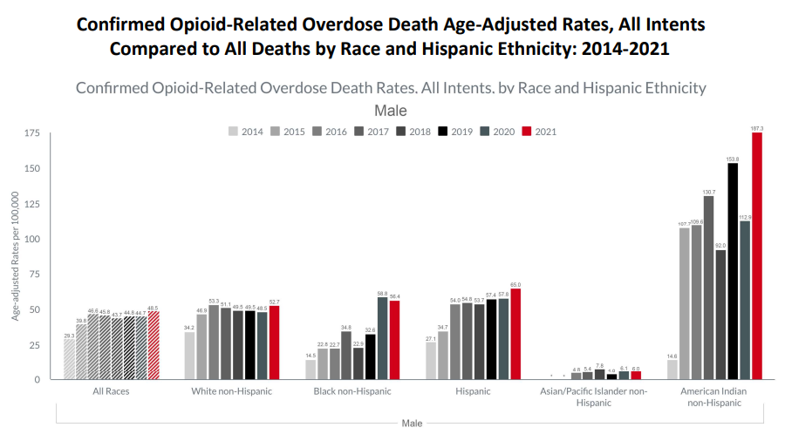
Opioid-Related Mortality in Massachusetts
Source: Massachusetts Registry of Vital Records and Statistics, MDPH • Population Estimates: Small Area Population Estimates 2011-2020, version 2018, Massachusetts Department of Public Health, Bureau of Environmental Health. Population estimates used for years following the decennial census were developed by the University of Massachusetts Donahue Institute (UMDI) in partnership with the Massachusetts Department of Public Health, Bureau of Environmental Health.

Slide 7
Voices from the Field: Massachusetts
Provide an overview of the opioid crisis in Latinx Communities
What do we need to tackle the crisis at the local, state and national levels?
What are some of the challenges in accessing services for individual from diverse Latinx communities?
Are there gaps in data that are tracking the crisis?

Slide 8
Please insert questions on Q & A chat box

Slide 9
Call to Action
What is one strategy you think can be better amplified to serve the Latinx community?
What is the impact, what is working, and what can we do to make it happen?
How can researchers assist in these efforts?

Slide 10
Announcements
Visit our website for other events & resources!
https://www.latinxknowledgehub.org

Slide 11
THANK YOU!

Slide 12
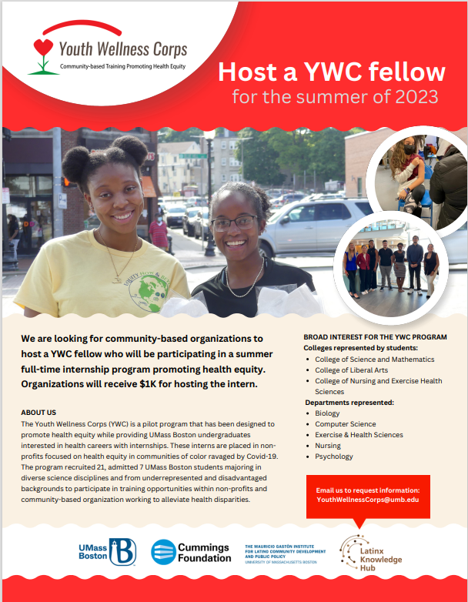
Know or need a YWC fellow?

